Slide 1

ASSIGENMENT – 1
PROBLEM SOLVING
BBA 1st SEM (2022-23)
Submitted By-
Vani saxena
Aashi Patel
Vanshika Sood
Gorisha Chawda
Kuldeep Jat
Shankh Bansal
Submitted To-
Mr. Amber Tiwari

Slide 2
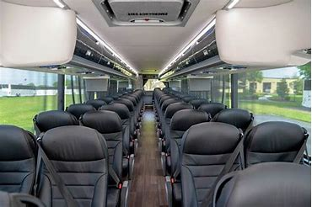
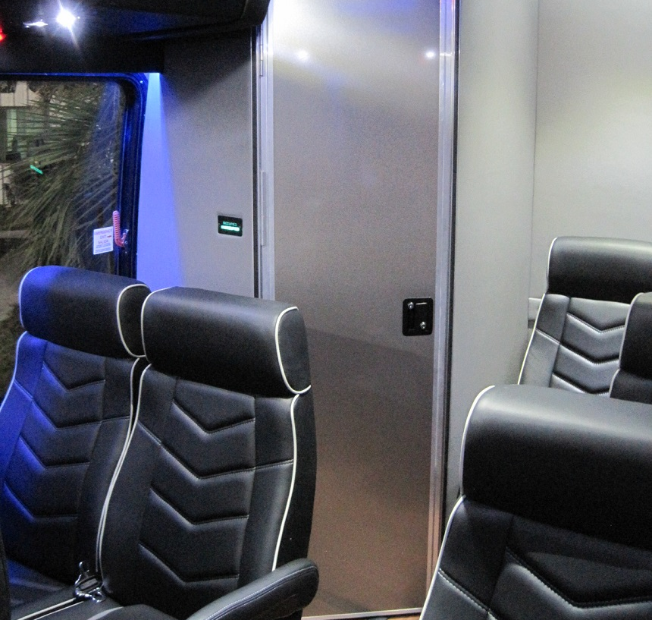
the problem why is there no washroom facility in buses?
Before
After

Slide 3
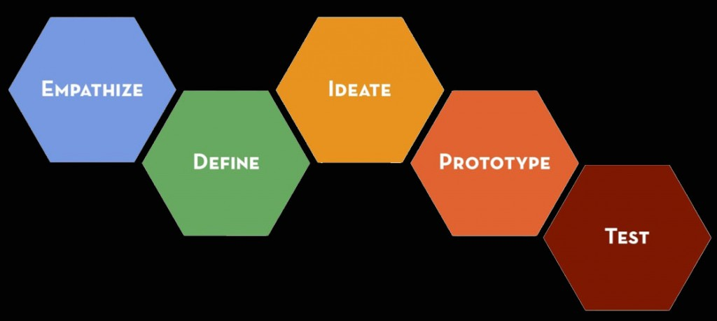
Solution steps

Slide 4
Background Information
What is your research?
People find it difficult to use washroom at any petrol pump, restaurants because they are poorly maintained.
sometimes people are shy to ask the driver to stop the bus.
sometimes people have the fear to go in washroom alone at night.
How did you discover this problem?
we came to discover the problem by a past incidence that has happened with me in the bus only.
we got the information to research about this problem and attempt to solve by-
Interviews
Personal experience
Internet/Books

Slide 5
Interviews we took

Slide 6
Empathies
What is their problem?
[all the buses are not having washroom facility inside the bus?]
Whom am I making this for?
[all the people who travel from bus for going to collage , office , school]
What do these people do?
[these people are basically- teenagers, youth, tourist, office folks ]

Slide 7
Advantages and disadvantages of having washroom in bus.
Advantages
it will create more employment.
it will increase people point of view for bus.
it can be used a strong point to bring more attraction towards the bus.
Disadvantages
It will cut off few members as it will occupies space.
It requires a proper maintenance in a regular period.
They are poorly managed and many of them are for employee use only .

Slide 8
define
What are the users need?
[To have washroom facility inside the bus.]
What are their problem?
[people find it difficult to ensure a clean washroom around them.]
What are their challenges?
[construct a fully usable toilet in limited space]
What are the insights we can use?
[we can construct a toilet which will become helping hand for many people.]

Slide 9
What is the biggest challenge?
If the bus contain a washroom, it will require a large amount of water which will reduce the bus efficiency.
Solution-
The washroom shall be more tilted toward air suction not on water which will reduce the weight , expenses and improve its efficiency.
Example- washrooms of airplanes.

Slide 10
Ideate
solutions
[All the buses shall contain a washroom.]
Ideas
[we shall create a washroom which should be fully functional in less expanses .]
Potential matches
[to create a ditto same washroom as on an airplane.]

Slide 11
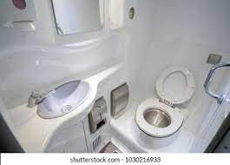
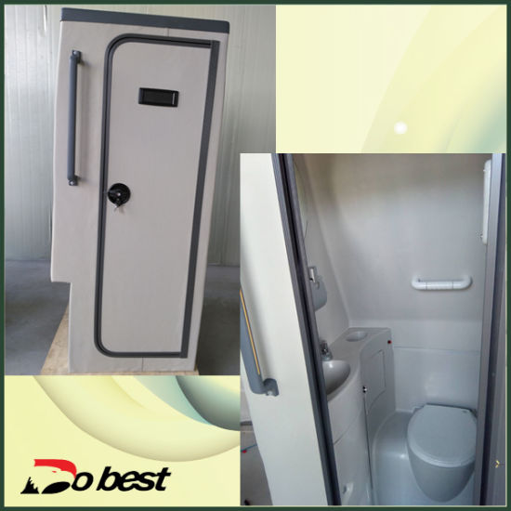
Some glimpse of imagination

Slide 12
prototype
Who can excess to the washroom
[All the member travelling in the bus can use the washroom free of cost.]
How will it look like?
[It will be in the back side of the bus, and it will look like a normal washroom.]

Slide 13
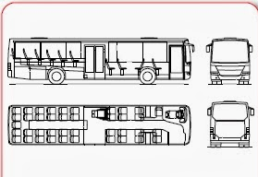
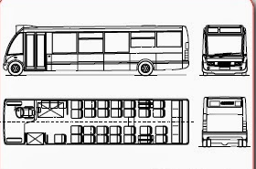
The Enovation we want

Slide 14
Test
It your prototype working?
[It is under testing phase]
[There is no disadvantages of this product, but it increases our work like washing , cleaning , maintaining etc.]
Is it easily available for all?
[All the person can easily use the washroom without any extra charge.]
Are there any flows in the product you discovered?

